Slide 1

Defence Institute of Advanced Technology
Deemed to be University, Girinagar, Pune
DEPARTMENT OF APPLIED MATHEMATICS
Course: Data Science Tools & Techniques (Lab)
Course Code: AM609L
SIR Epidemic Model with ODE Solvers
Sanghakara Manwar 26-27-13
Rohit Satpute 26-27-14
Shreya Gaur 26-27-15
Tanesh Devhare 26-14-05
Guided By :
Dr. Yogeshwar Singh Dadwhal
Assistant Professor
DIAT Pune

Slide 2
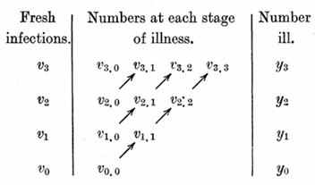
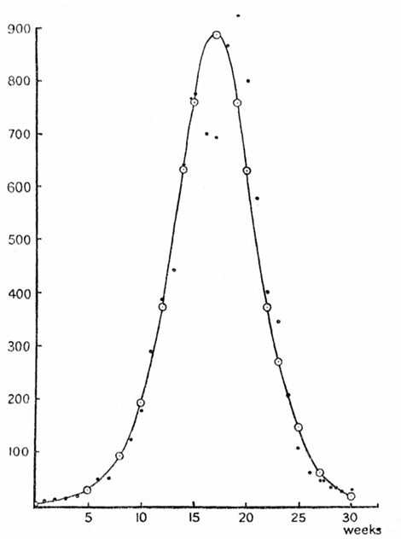
Project Overview & Objectives
The purpose of this project is to create a complete and rigorous ODE numerical solver and analysis framework capable of :
• Implement the Euler and RK4 methods for the SIR equations, and verify convergence orders and the analytical invariant.
• Estimate β and γ by grid search against real COVID-19 data (India and Japan).
• Compute R0 and run a “flattening the curve” scenario analysis.
• Bonus: fit historical Bombay City plague data (the executed analysis covers 1896–97).

Slide 3
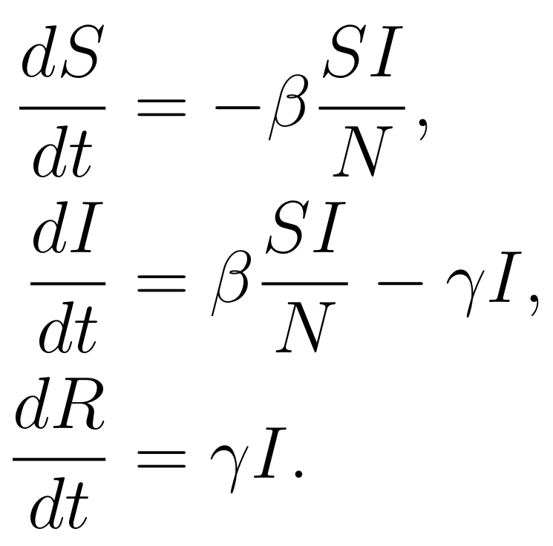
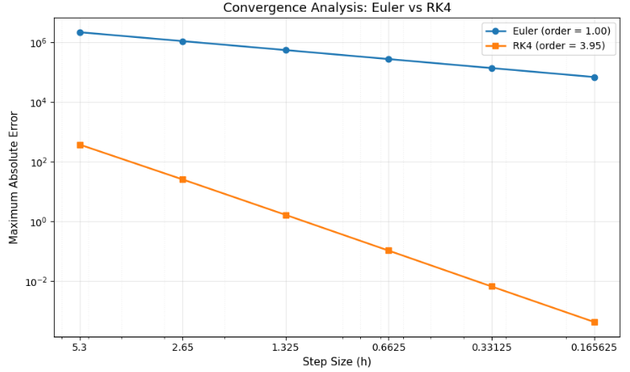

SIR Model & Numerical Methods
Equations
Euler | RK4
yₙ₊₁ = yₙ + h·f(tₙ,yₙ) | yₙ₊₁ = yₙ + (h/6)(k₁+2k₂+2k₃+k₄)
O(h) | O(h⁴)
1 | 4
Reference solution: SciPy solve_ivp, DOP853, rtol = 10⁻¹², atol = 10⁻¹⁴.
Test case: India parameter set:
N = 37,061,003; β = 0.095; γ = 0.0196; R₀ ≈ 4.85; (S₀, I₀, R₀) = (26,303,393; 185,837; 10,571,773); 0-212 days.
Steps tested: 40, 80, 160, 320, 640, 1280, so h = 5.3 down to 0.165625.
Error metric: E(h) = max |y_num − y_ref| over all time points and compartments.
Order: p = least-squares slope of log E vs log h.
Invariant:

Slide 4
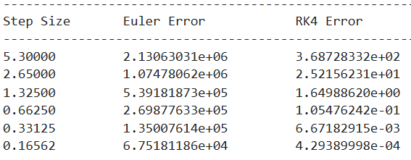
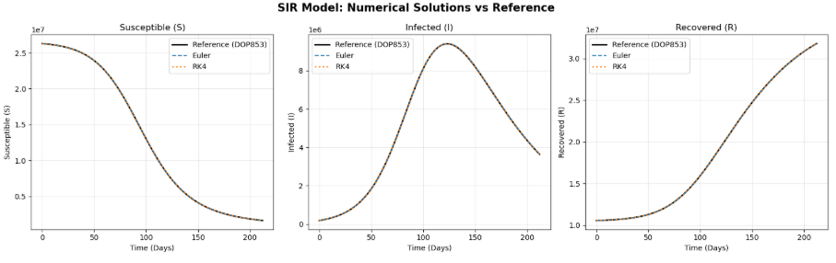
Numerical Validation
Takeaway: both methods hit their theoretical orders. At the finest step RK4 is about 10⁸ times more accurate than Euler (6.7×10⁴ vs 4.3×10⁻⁴).
Cost note: Euler’s absolute error is huge because I peaks near 10⁷ and the problem is stiff-ish in scale at coarse h.

Slide 5
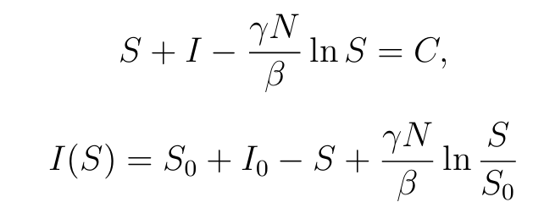
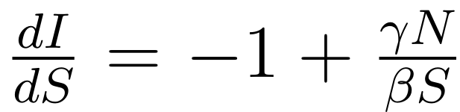
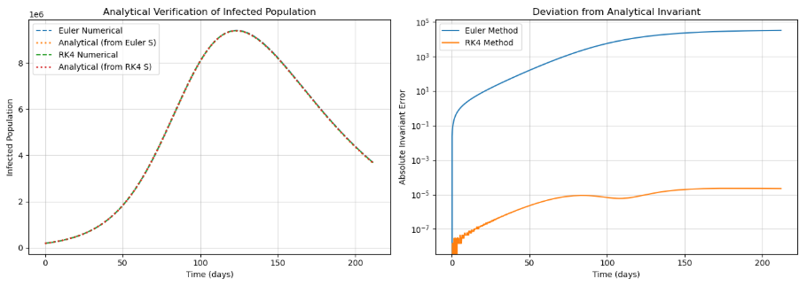
Analytical Verification
Equation :
This is a conservation law along trajectories, not a closed-form solution in t.
C = −104,148,888.78.
 | Euler | RK4
Max error, invariant-derived I | 3.159 × 10⁴ | 2.282 × 10⁻⁵
Max invariant error | 3.159 × 10⁴ | 2.283 × 10⁻⁵

Slide 6
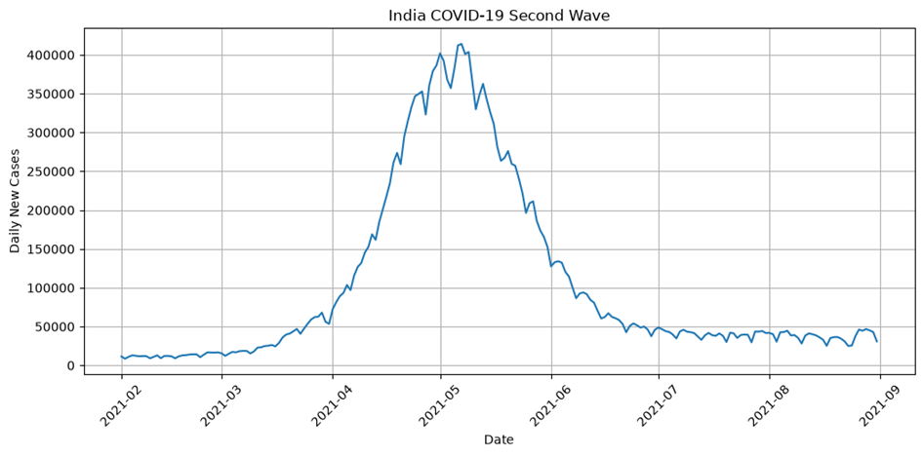
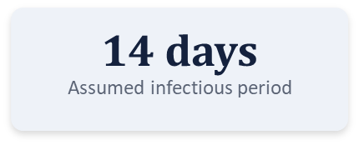
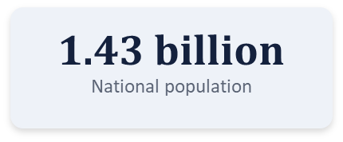
India: 2nd Wave Data (Feb–Aug 2021)
Selected Period: 1 February 2021 – 31 August 2021
Reason for Selection: This period captures the sharp rise in cases, the peak in May 2021, and the subsequent decline.

Slide 7
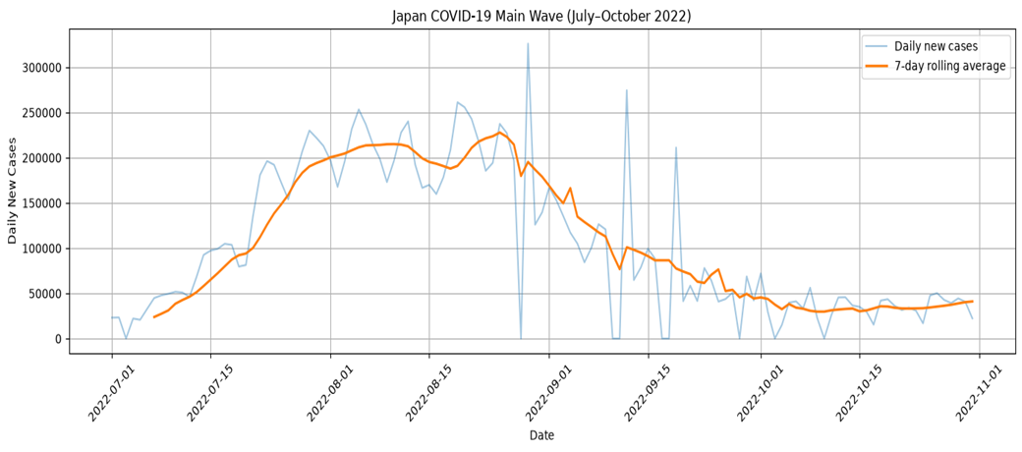
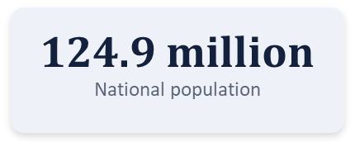
Japan: Summer Wave (Jul–Oct 2022)
Selected Period: 1 July 2022 – 31 October 2022
Reason for Selection: This period captures the major rise in cases during July–August 2022, the peak in August, and the decline afterwards.

Slide 8
India & Japan: Parameter Estimation
Parameter Estimation Technique
Used a two-stage grid search (coarse and fine) to identify the optimal parameter values.
Selected the parameter combination that minimized the error between model-predicted and actual weekly new infections.
Validation / Model Evaluation
Compared predicted and observed weekly infections.
Evaluated model fit using RMSE (lower is better) and R² score (closer to 1 is better).
Used actual vs predicted weekly case plots for visual comparison.
Parameters | India | Japan
Transmission rate (β) | 0.095 | 0.2663
Recovery rate (γ) | 0.0196 | 0.1093
Basic reproduction number (R₀) | 4.85 | 2.436

Slide 9
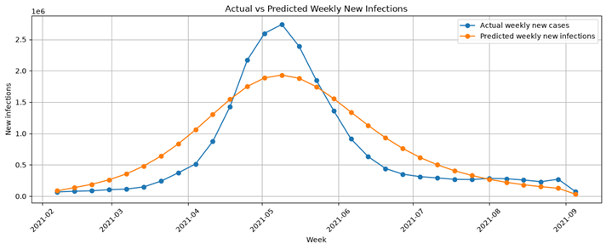
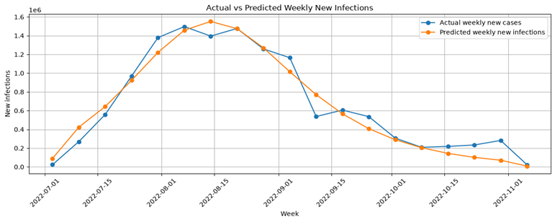
Comparative Analysis: India vs Japan
INDIA
Evaluation Metric | India | Japan
RMSE | 347,831 | 115,079.1
R² Score | 0.81 | 0.949
Effective Population | 2.6% | 22.67%
Comparative observations: SIR model fit for Japan vs India
Japan: The predicted and actual curves follow each other closely, both peaking at about 1.5M weekly cases in mid-August and declining steadily to near zero by November.
India: Both curves show a single wave, but the actual peak is sharper and higher (about 2.7M in early May) than the predicted peak (about 1.9M), and the predicted curve is broader, rising earlier and declining more slowly.
Tail: Both countries settle at low levels in the final weeks, with small variations in the actual data.
Overall: The model captures the timing and general shape of the wave in both countries, with a closer match for Japan than for India.
JAPAN

Slide 10
Flattening the Curve: Scenario Design
Flattening the curve slows infection rates to prevent hospital overloads.
Step 1: Set Initial Population: Define total population (N), initial susceptible (S0), infected (I0), and recovered (R{initial}) values.
Step 2: Define SIR Equations: Write the model function (sir_model) to calculate changes in Susceptible, Infected, and Recovered populations over time using transmission (beta) and recovery (gamma) rates.
Step 3: Create Scenarios: Set up comparison scenarios for different transmission rates (e.g., Higher transmission beta = 0.2663vs. Lower transmission beta = 0.1951)
.
Step 4: Run the Simulation: Use solve_ivp to simulate future infected population counts across the defined time window.
Step 5: Compare with Hospital Capacity: Plot the curves against a hospital capacity limit line to show how a lower transmission rate prevents medical overload.

Slide 11
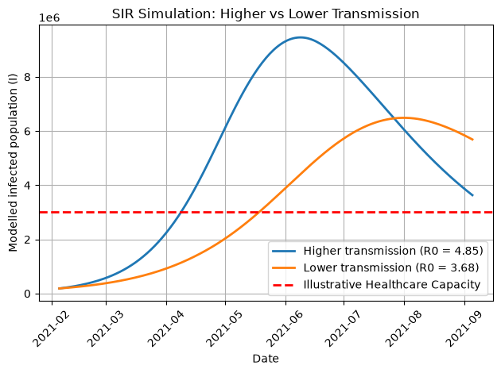
India: Intervention Impact
Scenario: Higher Transmission
Beta: 0.095
Gamma: 0.0196
R0: 4.85
Peak Infected: 9749217.21
Peak Day: 123
Scenario: Lower Transmission
Beta: 0.07
Gamma: 0.0196
R0: 3.68
Peak Day: 175

Slide 12
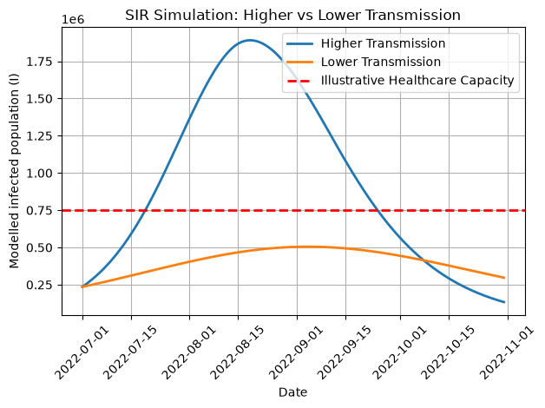
Japan: Intervention Impact
Scenario: Higher Transmission
Beta: 0.2663
Gamma: 0.1093
R0: 2.44
Peak Infected: 1890493.58
Peak Day: 49
Scenario: Lower Transmission
Beta: 0.1951
Gamma: 0.1093
R0: 1.78
Peak Infected: 505059.44
Peak Day: 65

Slide 13
Key Insight: Why Japan Fared Better
Lower Reproduction Number (R0): Japan's modeled R0 values (2.44 for higher transmission and 1.78 for lower transmission) are lower than India's (4.85 and 3.68), reflecting slower infection spread.
Impact of Lowering Transmission (beta): Reducing Japan's transmission rate parameter from beta = 0.2663 to 0.1951 effectively flattens the simulated peak infection curve
Healthcare Capacity Threshold: The simulation for Japan sets a distinct hospital capacity threshold of 750,000 cases to measure and control peak overflow risks
Initial Infection Proportions: Japan's initial susceptible-to-infected ratio (S0 = 18.9M, I0 = 235.4K out of N = 28.3M) resulted in a more manageable baseline outbreak scale in the model compared to India's higher R0 trajectory .

Slide 14
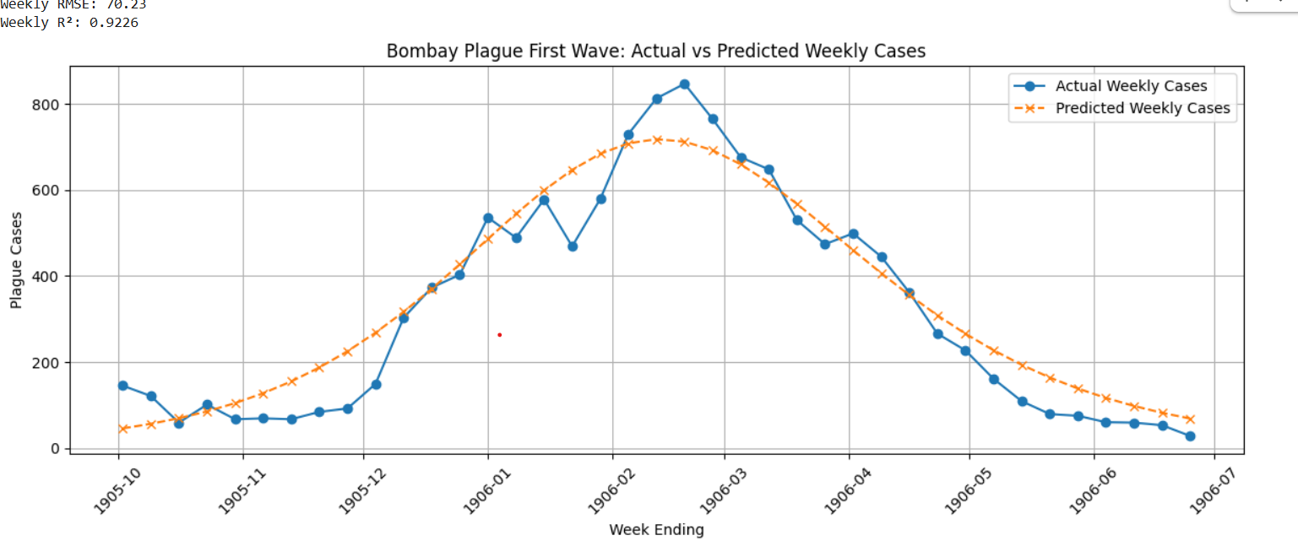
Bonus: Bombay Plague 1905–08
Beta (Transmission rate / week): 1.1071
Gamma (Recovery rate / week): 0.8929
Average infectious period: 1.12 weeks
Effective Population: 38,118 (4.64% of total)
Weekly RMSE: 70.23
Weekly R²: 0.9226

Slide 15
Conclusion
Methodological Superiority: RK4 significantly outperformed Euler, providing higher theoretical convergence and exact invariant preservation
Comparative Country Dynamics:
India (2nd Wave): Higher transmission (R0 ~ 4.85), longer infectious period (~ 51days), and 2.6% effective population fraction.
Japan (Summer Wave): Lower transmission (R0 ~ 2.44$), shorter infectious period (~ 9days), 22.7% effective population fraction, and strong model fit (R^2 = 0.95).
Flattening the Curve: A ~26% reduction in beta successfully flattened the infection peak and delayed the epidemic timeline.
Historical Robustness: Successfully validated across eras using historical data from the 1905–06 Bombay plague.

Slide 16
References
Research Paper: Kermack, W. O., & McKendrick, A. G. (1927). A Contribution to the Mathematical Theory of Epidemics. Proc. Royal Society A, 115(772), 700–721.
COVID-19 Dataset: Our World in Data (OWID) - COVID-19 Data Repository.
Historical Plague Data: Epidemic Models Repository, Bombay Plague Dataset ([github.com/Epidemic-Models/bombay_plague_bayesian_model](https://github.com/Epidemic-Models/bombay_plague_bayesian_model)).
Tools & Libraries: Python, NumPy, SciPy, Pandas, and Matplotlib for numerical simulation, parameter optimization, and data visualization.

